Slide 1

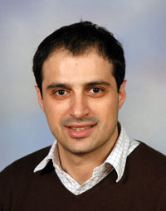


Telco Big Data Research and Open Problems
Constantinos Costa and Demetrios Zeinalipour-Yazti
Advanced Data Management Technologies Laboratory (ADMT) Dept. of Computer Science, University of Pittsburgh, 15213 Pittsburgh, PA, USA | Data Management Systems Laboratory (DMSL) Dept. of Computer Science, University of Cyprus, 1678 Nicosia, Cyprus
Slides: https://dmsl.cs.ucy.ac.cy/tutorials/icde19
IEEE ICDE 2019 - 35th IEEE International Conference on Data Engineering
Macau SAR, China, 8-12 April, 2019

Slide 2
Disclaimer
Feel free to use any of the following slides for educational purposes, however kindly acknowledge the source.
We would also like to know how you have used these slides, so please send us an email with comments or suggestions.
This presentation is available at: http://dmsl.cs.ucy.ac.cy/tutorials/icde19

Slide 3
About this Tutorial
The goal is to provide an overview of the unique characteristics, challenges and open problem of Telco Big Data (TBD) research.
We tackle the topic from a wide range of perspectives:
  Fundamentals, Definitions, Current State
  Academic / Industrial Perspective
  Reality / Visionary Scenarios, Future Challenges…
Lots of examples and illustrations to keep this presentation entertaining and educating.
The seminar captures the big picture, such that interested researchers/practitioners can expand their study by following the references.

Slide 4
Telcos
A Telecommunication company (Telco) is the entity that provides telecommunication services, such as telephony and data communication access to users.
  The radio and backbone infrastructure of such entities spans densely most urban spaces and widely most rural areas.
  Infrastructure generates data that encapsulate natural phenomena on an ongoing basis !

Slide 5
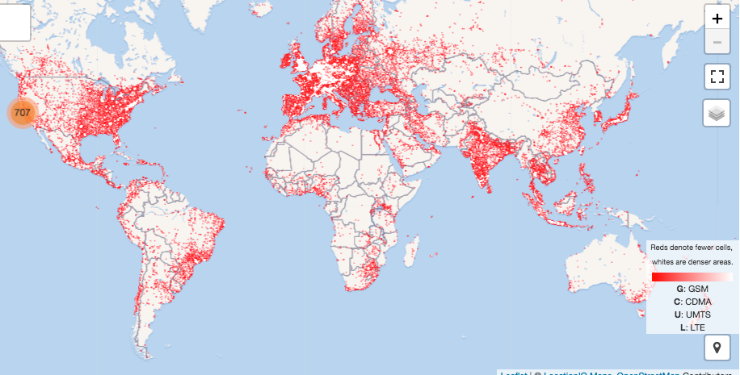
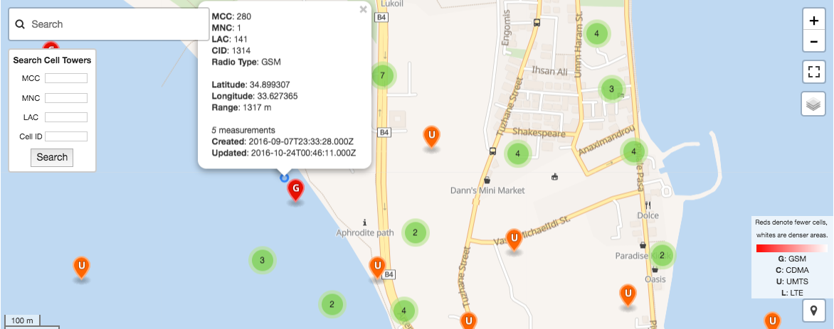
Telco Networks
Wide coverage of 2G, 3G, 4G and soon 5G (indoor – picocells)!
OpenCellID.org - The world's largest Open Database of Cell Towers

Slide 6
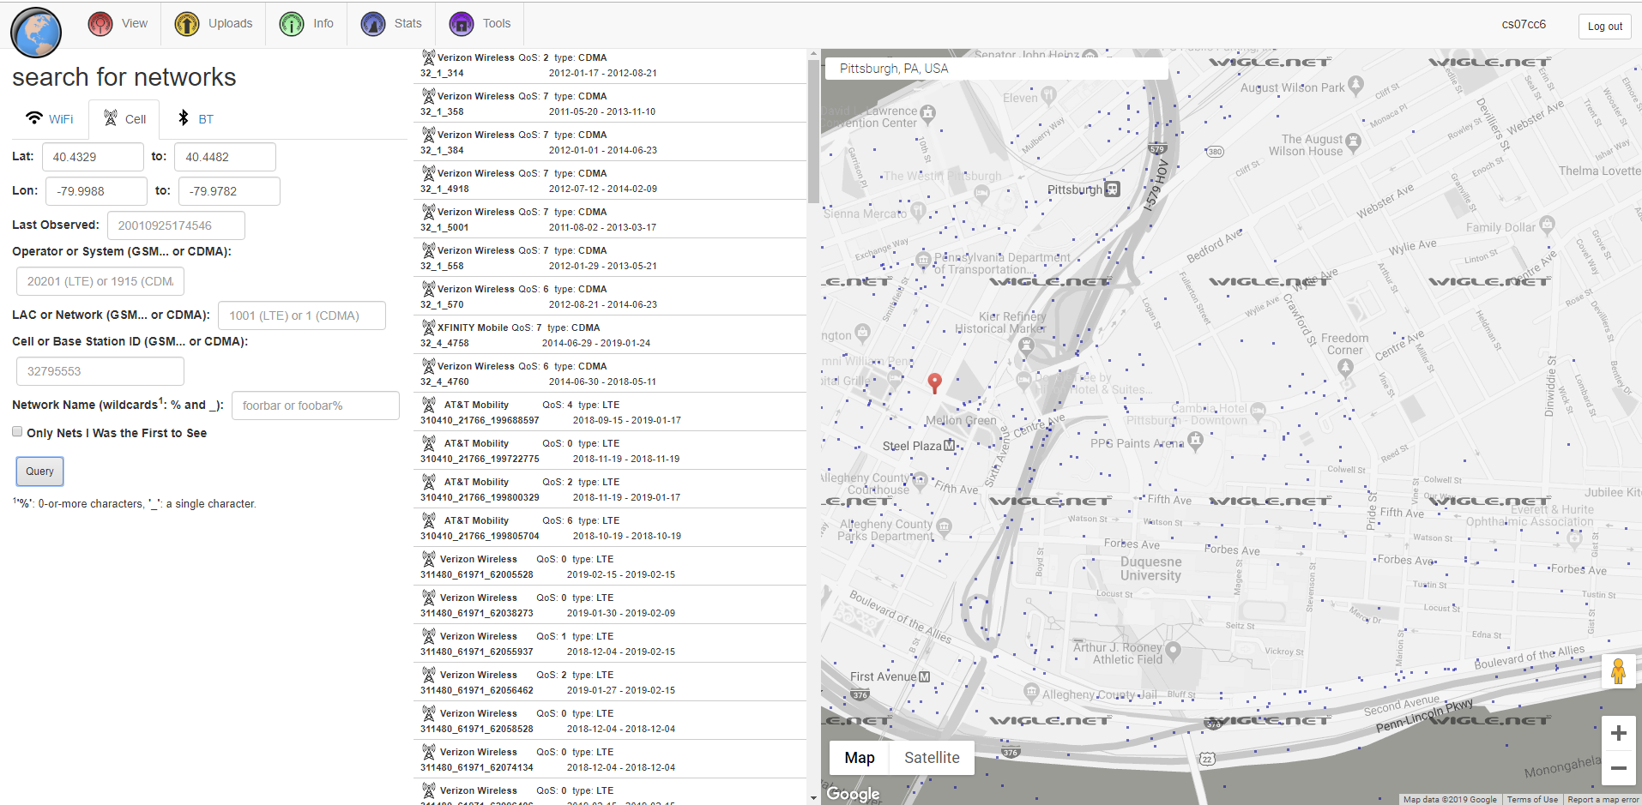
WiGLE
Map, query and update the database via the web
wigle.net - is a submission-based catalog of wireless network

Slide 7
Telco Big Data (TBD)
Telco Data: Traditional source for OLAP Data Warehouses and Analytics.
  e.g., Accounting, Billing, Session data.
  Problem: Inadequate data resolution to address biggest challenges:
    e.g., churn prediction, 5G network optimization, user-experience assessment, traffic mapping.
Telco Big Data (TBD): Velocity data generated at the cell towers.
  e.g., signal strength, call drops, bandwidth measurements.
  Size: 5TBs/day for 10M clients (i.e., 2PB/year).
RDBMS
Data Store

Slide 8

TBD Genesis
TBD Research started out in 2013-2014 and initially focused on finding new applications.
Orange Example (2013):
  ’Data for Development Senegal’ was an innovation challenge open on ICT Big Data for the purposes of societal development.
    Task: find interesting applications of TBD.
  Sonatel and the Orange Group are making anonymous data, extracted from the mobile network in Senegal, available to international research laboratories.
http://www.d4d.orange.com/en/Accueil

Slide 9
Orange D4D Challenge
Some winners of the challenge:
Using mobile phone data for electrification planning (provide capacity where needed).
  User Location + Electricity Data
National and Regional Road Network Optimization for Senegal Using Mobile Phone Data.
  Similar to TBD
Using mobile phone data for Spatial Planning simulation and Optimization Technologies (SPOT)

Slide 10
Industry Perspective
TBD Investments projected to grow
  50% of Telcos will invest in TBD (only 30% have done it by 2016)
    Source: McKinsey & Company Telecommunications “Telcos: The untapped promise of big data”, June 2016. https://goo.gl/mAHXib
The promise of unleashing the value of TBD has not been realized to this date!
  It merely focuses on some business/network cases:
Source: Key Big Data Use Cases for Telcos, Cloudera, 2015

Slide 11
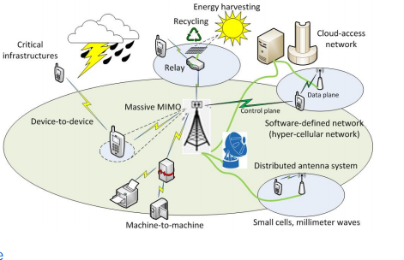
Mobile => Telco Revolution
5G (2020) is pushing
forward by popular demand:
Capacity (femtocells/relay)
  Standard (<35km), Microcell (<2km), Picocell (<200m), Femtocells (<10m).
  Better IoT integration, millimeter waves, massive MIMO, beamforming and full duplex.
Latency (<1ms)
Energy Consumption (ultra low)
Cost (ultra low)
Data Rates (>10Gbps)
Coverage (100Mbps)
5G Energy: https://goo.gl/7y53eb
5G: https://goo.gl/Pwu4ug
Quote: This is not the end. It is not even the beginning of the end. But it is, perhaps, the end of the beginning - Winston Churchill
Things will come and go in this trajectory:
  Go: SMS overtaken by OTT (Over-The-Top) media
  Come:
    Unlimited data plans and higher speeds for users (e.g., for streaming media, mixed (augmented + virtual) reality.
    Supporting the march of IoT.
Notes:
https://www.irit.fr/networking2015/files/keynote-Mammela.pdf

Slide 12
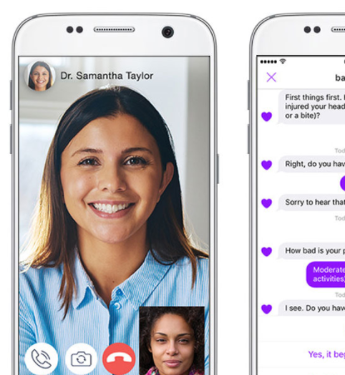

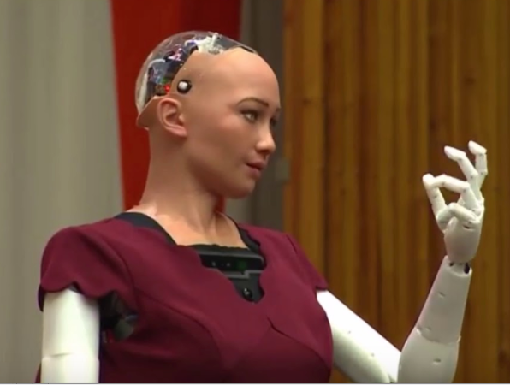
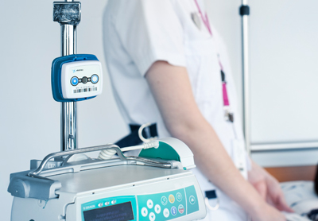
Mobile => Telco Revolution
March 2017: “U.S. consumers now spend 5 hours per day on mobile devices” – TechCrunch (Flurry)
2020: Mobile Data is expected to explode even further in the future with the advent of: IoT hardware, high-bandwidth/low-latency networks, cloud/fog computing.
  Human Population: 8 Billion - UN DESA
  SIM Cards: 5.8 Billion - abiresearch.com
  Wi-Fi: 41 Billion active Wi-Fi devices – information-age.com
  Devices: 20 Billion Connected devices
Navigation
Telemedicine
Transportation
Social Engagement
Transportation / Smart Cars
Precision Agriculture / Agritech
eHealth
Social (Sophia) Humanoids
Manufacturing / Logistics
Notes:
MCUs: Microcontroller
https://techcrunch.com/2017/03/03/u-s-consumers-now-spend-5-hours-per-day-on-mobile-devices/
https://goo.gl/c6VTWG

Slide 13
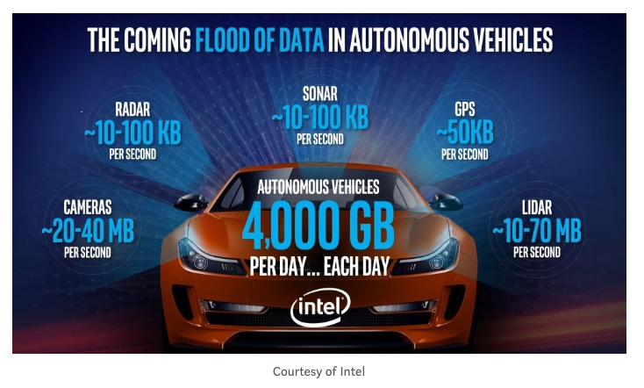
Mobile => Telco Revolution
Notes:
Today: 60 MCUs per US house + 60 MCUs in a car!
https://www.abiresearch.com/press/global-sim-card-shipments-exceed-58-billion-2020-d/

Slide 14
Outline
Introduction
What is Telco Big Data?
Research State & Open Problems
  Real-time & Offline Analytics
  Churn Prediction
  Privacy
  Storage
  Road Traffic Mapping
  Visual Exploration

Slide 15
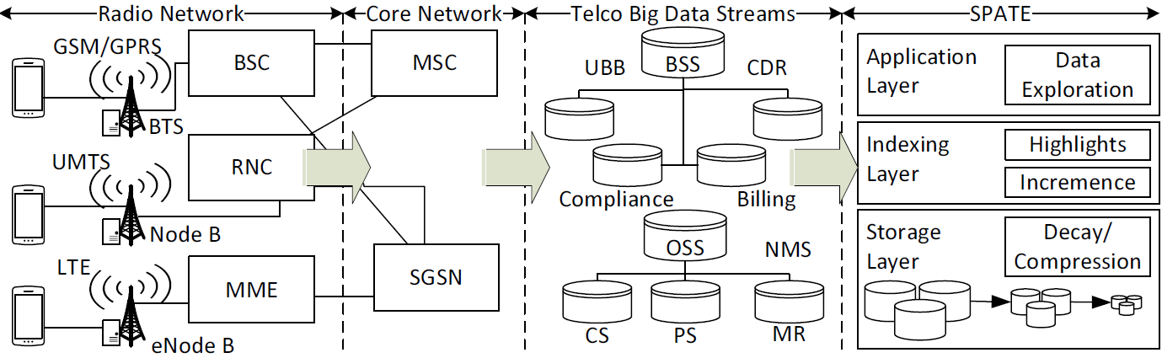
TBD Network
Radio & Core Network
  Generate Streams of IP packets from the GSM/GPRS (2G), UMTS (3G), LTE (4G) antennas.

Slide 16
TBD Streams
Call Quality
Measurement Reports (can be used to localize users with triangulation ~50 meters)
Data quality (web speed, connection success rate)
Telco Big Data (TBD)
  Business Supporting Systems (BSS) data
    Tens of GB/day for a xM+ city
  Operating Supporting Systems (OSS) data
    Tens of TB/day for a xM+ city

Slide 17
Call Detailed Record (CDR)
CDR: Records produced by a telephone exchange or other telecommunications equipment that documents the details of a telephone call or other telecommunications transaction (e.g., text message) that passes through that facility or device. – Wikipedia
  Contains: time, duration, completion status, source number, and destination number
  Each CDR says when session began and when it ended (but will not show the in-between behavior)
  Collected every ~ 30 minutes in datacenter (not real time)
Not a real source of TBD, but a complementary source. (collected inside Relational Databases).
Most (if not all) of academic studies use this type of data only (as opposed to Network Measurements)

Slide 18
Measurement Reports (MR)*
C1
RSSi: -90dBm
PCHR
RSSi: -30dBm
PCHR
C2
IMSI:XYZ
PCHR
PCHR
(C1, call drops, 10)
(C1, handover_attempts, 40, handovers_success, 30)
(IMSI:XYZ, C1:-30, C2:-90)
* Alternative: Mobile BroadBand (MBB) OR Network Measurement System (NMS) data

Slide 19
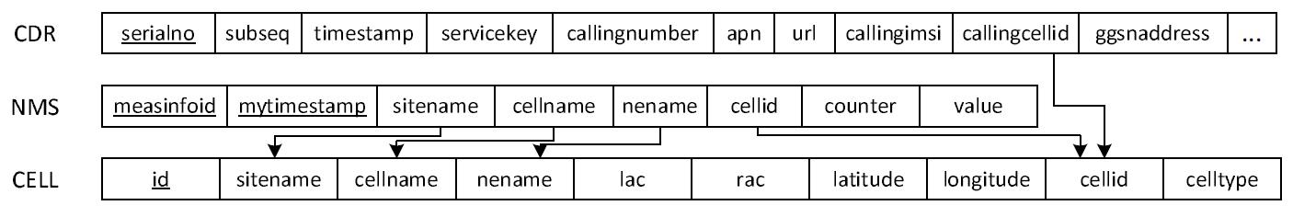
TBD Relational Diagram
TBD can logically be represented by a relational diagram.
  Hundreds of Attributes (e.g., 200) & Millions of Rows
  Foreign Keys enable join operations to yield answers to more complex queries
  Location of users is not in TBD (but can be triangulated from MR data ~ approx. 50m accuracy)
  Proprietary data formats make it difficult to expand the TBD schema (e.g., radio-propagation models)

Slide 20
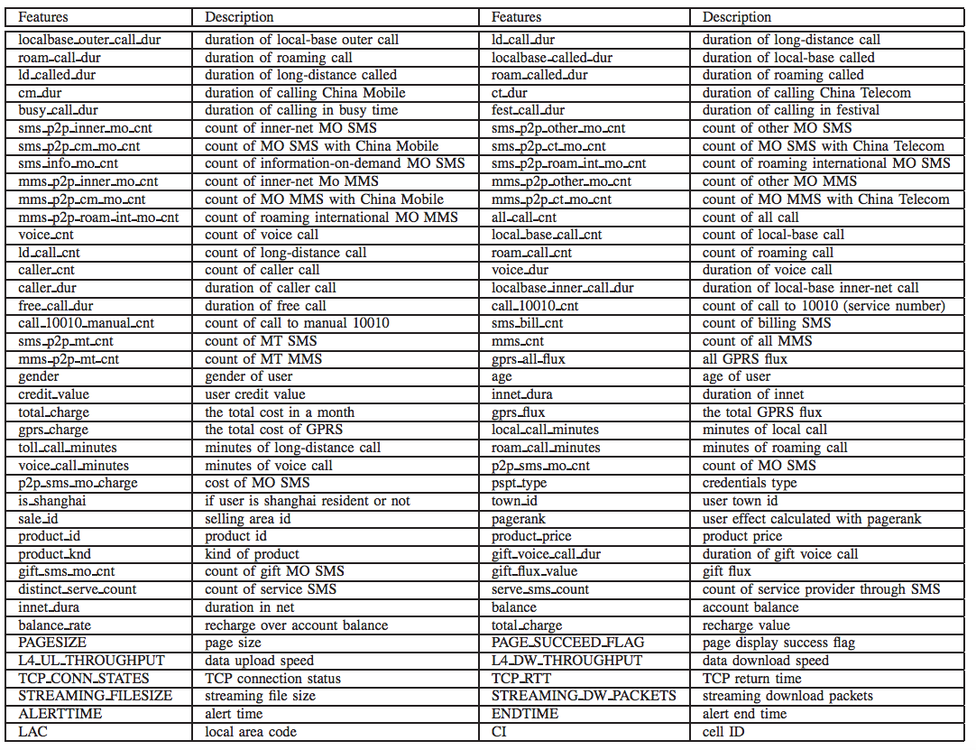
TBD Data
CDR
A Closer Look at KPIs for Churn Prediction
Yiqing Huang, Fangzhou Zhu, Mingxuan Yuan, Ke Deng, Yanhua Li, Bing Ni, Wenyuan Dai, Qiang Yang, and Jia Zeng. 2015. Telco Churn Prediction with Big Data. In Proceedings of the 2015 ACM SIGMOD International Conference on Management of Data (SIGMOD '15). ACM, New York, NY, USA, 607-618. DOI: https://doi.org/10.1145/2723372.2742794

Slide 21
Telco Data Identifiers / SIM
ICCID = Integrated Circuit Card ID.
  SIM (Subscriber Identity Module) card identifier
  SIM data (including the IMSI) can change, but ICCID remains the same.
IMSI = International Mobile Subscriber Identity.
  primary identifier of a subscriber GSM/UMTS/LTE networks
  Format: MCC-MNC-MSIN
    MCC = Mobile Country Code (e.g. 310 for USA);
    MNC = Mobile Network Code (e.g. 410 for AT&T),
    MSIN = sequential serial number.
  Stored on SIM card.
ICCID Example:
IMSI Example:
310 410 123456789

Slide 22
TBD Identifiers / Phones
IMEI = International Mobile Equipment Identity
  Phone Device Identifier (typically found behind the battery.)
  IMEI numbers of cellular phones connected to a GSM network are stored in a database (EIR - Equipment Identity Register) at Telco or National DB – useful for stolen invalid type devices.
  Dual SIM phones usually have two IMEIx
  In HEX format = Mobile Equipment Identifier (MEID)
MSISDN = Mobile Station ISDN
  Phone Number Identifier of a subscriber, including the national country code (e.g. 001 for US, 357 for Cyprus).
  A subscriber can have multiple MSISDNs (e.g. one phone number for business, one for personal calls, one for fax, etc.), but generally only one IMSI.
  The MSISDN is never signaled to or from the device. The MSISDN does not need to be stored on the SIM card.
Cyprus / Nicosia MSISDN Example:
357 99 111111

Slide 23
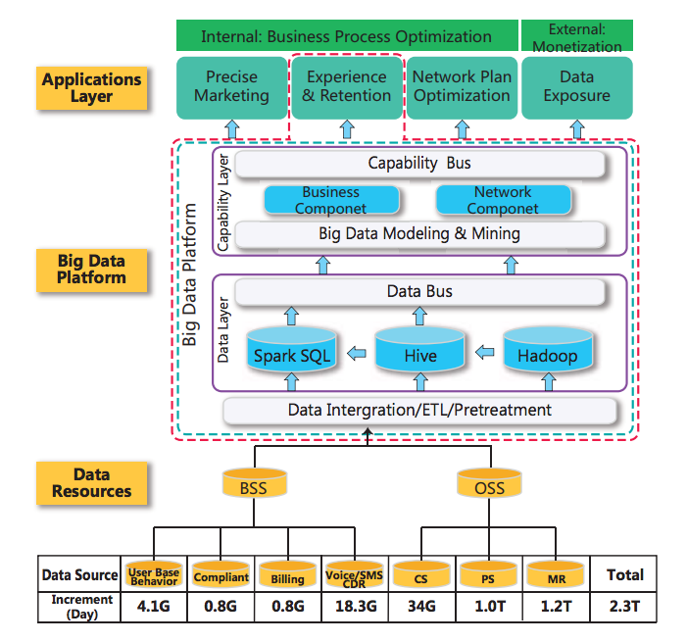
Industry/Academic Architecture
Yiqing Huang, Fangzhou Zhu, Mingxuan Yuan, Ke Deng, Yanhua Li, Bing Ni, Wenyuan Dai, Qiang Yang, and Jia Zeng. 2015. Telco Churn Prediction with Big Data. In Proceedings of the 2015 ACM SIGMOD International Conference on Management of Data (SIGMOD '15). ACM, New York, NY, USA, 607-618. DOI: https://doi.org/10.1145/2723372.2742794

Slide 24
Industry Perspective - Huawei
FusionInsight - Huawei’s Architecture built on Spark, Storm, MR, etc. – focused on services rather than technical insights.
http://carrier.huawei.com/en/technical-topics/carrier-software/big-data-analytics/improve%20telco%20big%20data%20efficiency%20and%20utilization

Slide 25
Outline
Introduction
What is Telco Big Data?
Research State & Open Problems
  Real-time & Offline Analytics
  Churn Prediction
  Privacy
  Storage
  Road Traffic Mapping
  Visual Exploration

Slide 26
Real-time & Offline Analytics
On/Off Analytics
Motivation: Most existing big-data analytics systems are built on top of an offline (data-at-rest) MapReduce-style infrastructures
  inherently limits the possibilities for online control!
Problem: How can we perform online/real-time/interactive (data-in-motion) and offline analytics (data-at-rest) efficiently over TBD?
Solution:
  Adapt/Wire existing distributed architectures to cope with the specific requirements of TBD.
S. Zhang, Y. Yang, W. Fan, L. Lan, and M. Yuan, “Oceanrt: Real-time analytics over large temporal data”, SIGMOD ’14 (demo)
Noah’s Ark Lab, Hong Kong

Slide 27
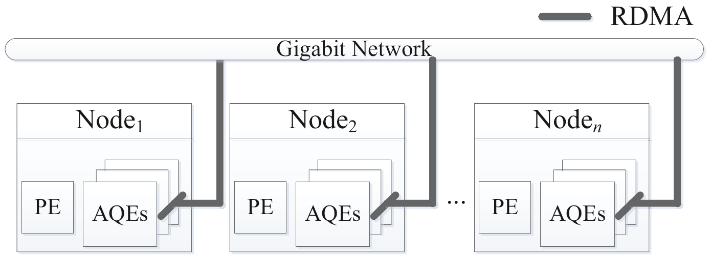
OceanRT
On/Off Analytics
One of the first real-time TBD analytic system that aims to exploit: i) Relational Query Optimizers (Postgres) and ii) Hadoop Remote Direct Memory Access; as opposed to the execution runtime of Hadoop/Spark/Storm/etc.
Idea: New distributed interconnected nodes with Access-Query Engines (AQEs) and a Parsing Engine (PE) - explained next.
Claimed Benefits:
  12x faster than Shark
  200x faster than Hive
  10x faster than Impala
Remark:
Super-optimized architecture for specific purpose :-(, no fault tolerance, no speculative execution, etc. - also just a demo so ideas not fully detailed
RDMA: Remote Direct Memroy Access
PE: Parsing Engine
AQE: Access Query Engines

Slide 28
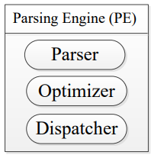
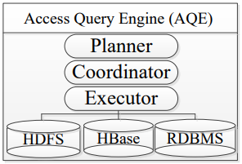
OceanRT
On/Off Analytics
Parsing Engine (PE)
  Parser: parses the SQL queries into execution plans
  Optimizer: optimizes the plans with Postgres.
  Dispatcher: routes the query to nodes that stores relevant data
Access-Query Engine (AQE)
  executes the plan
  generates (intermediate) results
  can read/write data in HDFS,
  HBase, or RDBMS

Slide 29
OceanST
On/Off Analytics
Another demo by the Huawei (Noah’s Ark Lab, Hong Kong) in the same year but at VLDB’14!
Deals with the same problem but applies a different architecture with following key points:
  Based on Spark / MapReduce, so not reinventing the wheel and is fully compatible with the Hadoop ecosystem.
  Introduces TBD-specific ideas in 3 layers: storage, functional and application (see next) – the genesis of the TBD stack that influenced other systems
M. Yuan, K. Deng, J. Zeng, Y. Li, B. Ni, X. He, F. Wang, W. Dai, and Q. Yang, “Oceanst: A distributed analytic system for large-scale spatiotemporal mobile broadband data”, VLDB 2014.
Noah’s Ark Lab, Hong Kong

Slide 30
OceanST
On/Off Analytics
OceanST consists of three layers:
  Distributed Data Storage Layer
    HDFS
    Hierarchical Indexing
    File level indexing
  Functional Layer
    Exact Solution
    Approximate Solution
  Application Layer
    graphic user interface (GUI)
    complex analytic tasks
M. Yuan, K. Deng, J. Zeng, Y. Li, B. Ni, X. He, F. Wang, W. Dai, and Q. Yang, “Oceanst: A distributed analytic system for large-scale spatiotemporal mobile broadband data”, VLDB 2014.

Slide 31
OceanST: Storage Layer
On/Off Analytics
All the records and indices are stored as regular files on HDFS with a 3-level partitioning scheme.
OceanST Partitioning:
  Level 1 (Bucket): hash values of user id and coarse ranges of time.
  Level 2 (Region): spatial index on location (long, lat).
  Level 3 (Block): finer ranges of time + actual data in 64MB blocks (i.e., HDFS v1 block sizes).
Two additional OceanST data structures to support advanced and approximate querying:
  In-block index (for level 3) – avoid scanning the whole block. e.g., “count users within 100m of some road for specific time”
  Inverted Index: to index specific records that maintain under the Mobile_App_Type (e.g., the string “IPhone”).
M. Yuan, K. Deng, J. Zeng, Y. Li, B. Ni, X. He, F. Wang, W. Dai, and Q. Yang, “Oceanst: A distributed analytic system for large-scale spatiotemporal mobile broadband data”, VLDB 2014.

Slide 32
OceanST: Functional Layer
On/Off Analytics
Introduces quite innovative the notion of Exact & Approximate solutions (not available in typical relational query optimizers)
Exact Solution
  Various TBD-specific queries where computation of aggregates is amortized over time.
  Examples: given 2 points find routes used by user, top-k locations users came from, predict next location of user, find home and work location of user, etc.
  Remark: very user-specific queries (as opposed to be focusing on general trends), yielding serious privacy concerns.
Approximate Solution
  Concurrent Random Index Sampling (CRIS) algorithm: answers within a guaranteed error bound:
    stratified sampling
    overlapping sample reuse on concurrent
    trajectory aggregate queries
M. Yuan, K. Deng, J. Zeng, Y. Li, B. Ni, X. He, F. Wang, W. Dai, and Q. Yang, “Oceanst: A distributed analytic system for large-scale spatiotemporal mobile broadband data”, VLDB 2014.

Slide 33
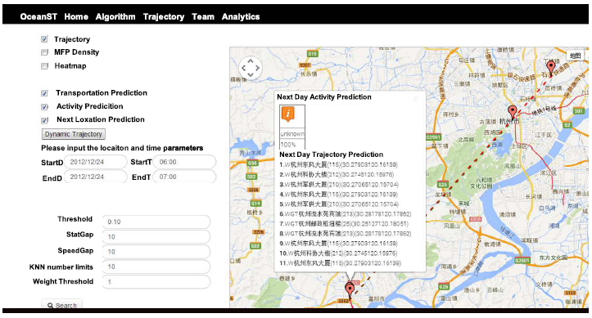
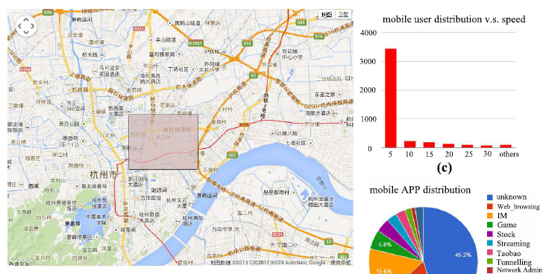
OceanST: Application Layer
On/Off Analytics
One of the first systems to discuss a map-based exploration interface.
Graphic user interface
  Web based using a map
  Temporal input
  Communicate with the functional layer using a API
Specialized components
  Advertising agency (where to advertise?)
  Telco carrier optimizations
  Government agency apps
M. Yuan, K. Deng, J. Zeng, Y. Li, B. Ni, X. He, F. Wang, W. Dai, and Q. Yang, “Oceanst: A distributed analytic system for large-scale spatiotemporal mobile broadband data”, VLDB 2014.

Slide 34
Outline
Introduction
What is Telco Big Data?
Research State & Open Problems
  Real-time & Offline Analytics
  Churn Prediction
  Privacy
  Storage
  Road Traffic Mapping
  Visual Exploration

Slide 35
TBD Churn Prediction
Churn Prediction
Churn Prediction: predict which customers will leave the Telco.
  Cost of acquiring new customer 3x higher than retaining existing customers.
  Probably the most important query from a Telco standpoint.
  Churn prediction is traditionally carried out with BSS (Business Support System Data, e.g., billing from CDR) => Precision ~50% ☹
  Churn prediction with OSS (Operation Support Data, e.g., NMS) => Precision 95% ☺ Privacy ☹ (revisited)
Y. Huang, F. Zhu, M. Yuan, K. Deng, Y. Li, B. Ni, W. Dai, Q. Yang, and J. Zeng, “Telco churn prediction with big data”, SIGMOD, 2015.

Slide 36
TBD Churn Prediction
Churn Prediction
Approach Overview
  TBD Architecture presented earlier & Feature Engineering using Spark => generate large table with the KPI/KQI (Key Performance Indicators/Key Quality Indicator)
    Baseline Features (CDR, other)
    CS Features (Call Quality)
    PS Features (Data quality - web speed, connection success)
    Some MR features (i.e., top-5 customer locations)
    Graph Features: Call Graph, Message Graph, Co-occurrence Graph , i.e., Pagerank & Label Propagation.
    Topic Features: customer complaint logs in compact LDA model (from NLP) - statistical model for discovering the abstract "topics" that occur in a collection of documents
  Random Forest Classifier used to make predictions.
Y. Huang, F. Zhu, M. Yuan, K. Deng, Y. Li, B. Ni, W. Dai, Q. Yang, and J. Zeng, “Telco churn prediction with big data”, SIGMOD, 2015.

Slide 37
Outline
Introduction
What is Telco Big Data?
Research State & Open Problems
  Real-time & Offline Analytics
  Churn Prediction
  Privacy
  Storage
  Road Traffic Mapping
  Visual Exploration

Slide 38
Privacy & GDPR
Privacy
Privacy in General: If personal identifiers (SSN, Phone number, IMSI, etc) are missing from the data, then its not considered Personally Identifiable data.
Privacy in Legal terms: How to safely frame the collection, processing and transfer of personal data? EU GDPR, May 25th, 2018:
  Principles of personal data processing: consent, processing of special categories of personal data, criminal convictions, children, …
  Rights of data subject: access (transparency), erasure, restriction, portability, …
  Controller & Processor: responsibilities, cooperation, security, DPO – Data Protection Officer, Codes of Conduct, …
  Transfer of Personal Data: legally-binding rules, ..
  Supervisory Committees , Cooperation & Consistency
  Remedies, liability & Penalties

Slide 39
Probabilistic Privacy
Privacy
A) Data Sharing (Generalization)
  k-anonymity: making every record indistinguishable among k other records (Samarati & Sweeney) – using generalization of the quasi-identifiers.
  l-diversity and t-closeness: refinements that seek to prevent the variability of the confidential attributes within a k-anonymous group from being too small (diversity in distribution).
B) Interactive Databases (Randomization)
  ε-differential privacy: originated as a model for interactive databases and seeks to limit the knowledge that users obtain from query responses. (e.g., adding laplace noise)
==> Both models are often presented as antagonistic:
  ε-differential privacy supporters view k-anonymity as an old-fashioned privacy notion that offers only poor disclosure limitation guarantees,
  ε-differential privacy detractors criticize the limited utility of ε-differentially private outputs and the cumbersomeness of not having access to the data set.
Joint UNECE/Eurostat work session on statistical data confidentiality (Ottawa, Canada, 28-30 October 2013), “Connecting privacy models: synergies between k-anonymity, t-closeness and differential privacy”.. Jordi Soria-Comas and Josep Domingo-Ferrer, Universitat Rovira i Virgili, Catalonia, Spain. https://www.unece.org/fileadmin/DAM/stats/documents/ece/ces/ge.46/2013/Topic_2_soria-comas_domingo-ferrer.pdf

Slide 40
TBD Privacy
Privacy
General Problem: How to bring Probabilistic Privacy models to TBD architectures?
Specific Problem: Differential Privacy (DP) architectures lead to a 15-30% accuracy loss.
  ➔ Real-world industry data mining workers cannot work well under such a string privacy guarantee.
Proposition: Implement 3 different DP implementations of Decision Trees for the churn reduction and make recommendations for DP adoption (as strongest privacy model).
X. Hu, M. Yuan, J. Yao, Y. Deng, L. Chen, Q. Yang, H. Guan, and J. Zeng, “Differential privacy in telco big data platform”, VLDB, 2015.

Slide 41
Outline
Introduction
What is Telco Big Data?
Research State & Open Problems
  Real-time & Offline Analytics
  Churn Prediction
  Privacy
  Storage
  Road Traffic Mapping
  Visual Exploration

Slide 42
Storage
Storage
The Big data era lead us to a point where organizations collect more than they can!
  Scale:
    Global volume of stored data doubling every 2 years.
    44 zettabytes of data in 2020 (44 billion TB of data)
  Costs:
    Costs for data storage decline only at a rate of less than 1/5 per year. Datacenter Journal, https://goo.gl/o4MnJp
    An 1 PB Hadoop cluster, using between 125 and 250 nodes, costs ~1M USD
  Time:
    A linear scan of 1PB would require ~15 hours
TBD is straining telco datacenters that can not benefit from economies-of-scale available on public clouds (due to confidentiality/security).
  highly sensitive attributes of user data located in TBD (e.g., billing records, calling numbers, call duration)
Source: 2016 Western Digital Corporation.

Slide 43
How to Reduce Data ?
Storage
Data Sampling
  Uniform or Random Data < Original Data
Data Aggregation (Data Cubes)
  Query Result Data < Original Data
Data Reduction (SVD, DFT, DWT)
  Principal Components (Patterns) << Original Data
Data Synopsis (e.g. equiwidth/depth histograms, Bloom filters, sketches)
  “Statistics” about Data << Original Data
Data Compression (lossless or lossy)
  Combination of the above techniques
Problem: None of the above considers how to outdate (decay) data as time elapses.
Notes:
DFT (Discrete Fourier Transform): Any random signal is a summation of simple sinusoidal signals (simple (non-important) components + principal components).
count-min (counting filters): same with bloom filters only that each bucket keeps an integer (counting the occurrence). So the problem is how to infer the “count” overlaps of these counters
Bloom Vector: [0, 1, 1, 0, 0, 1]
Bloom Filters: Tell me if X is part of the result
Count-MIN Vector: [12, 23, 0, 12, 43]
Count-Min Filters: Tell me minimum number of times X is part of the result. (Tell me frequency of X in results)
How? Worse Guest: to take the largest, i.e., 12. Best Guess: to take “0” (X was never added to Vector)
Example: [12, 23, 0, 12, 43] (bold shows query buckets)
The smallest is 12.
Very similar to histograms (ranges) vs sketches (hashes). Sketches do rely on statistics to allow a tradeoff between worse and best guess.
FM-sketch (Flajolet-Martin Sketch): Similar to Count-min sketch, but each bucket now retain a record for N various items you want to track. (i.e., find at the end count for specific item, e.g., track persons that looked at some advertisments) – HLL Sketches (similar)

Slide 44
SPATE: Overview
Storage
SPATE has 3 layers:
  Storage layer
    compression logic
  Indexing layer
    minimizing the query response time for data exploration queries
    gradual decay the data
  Application layer
    querying module
    user interface

Slide 45
Storage Layer: Compression
Storage
Compression refers to the encoding of data using fewer bits than the original representation
Benefits:
  Shifts the resource bottlenecks from storage- and network-I/O to CPU (cycles increasing faster).
  Save enormous amounts of storage and I/O on subsequent analytic tasks!
Desiderata: Given a setting where TBD arrives periodically in batches, we want to:
  minimize the space needed to store/archive data
  minimize response time for spatiotemporal data exploration queries

Slide 46
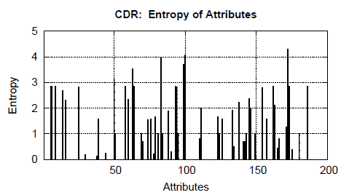
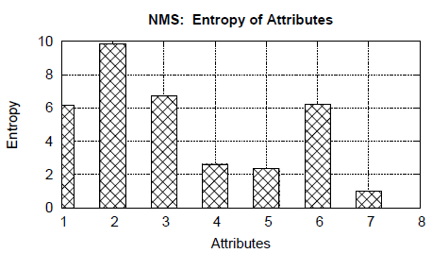
Storage Layer: Compression
Storage
We analyzed an anonymized real TBD dataset to understand what compression ratios can be achieved?
  Dataset: 1 week, 1.7M CDR, 21M NMS, 300K users
  Tool: Shannon’s entropy (typical measure for the maximum compressibility of a dataset)
  Observation: TBD contains significant redundancy (Entropy close to 0)!

Slide 47
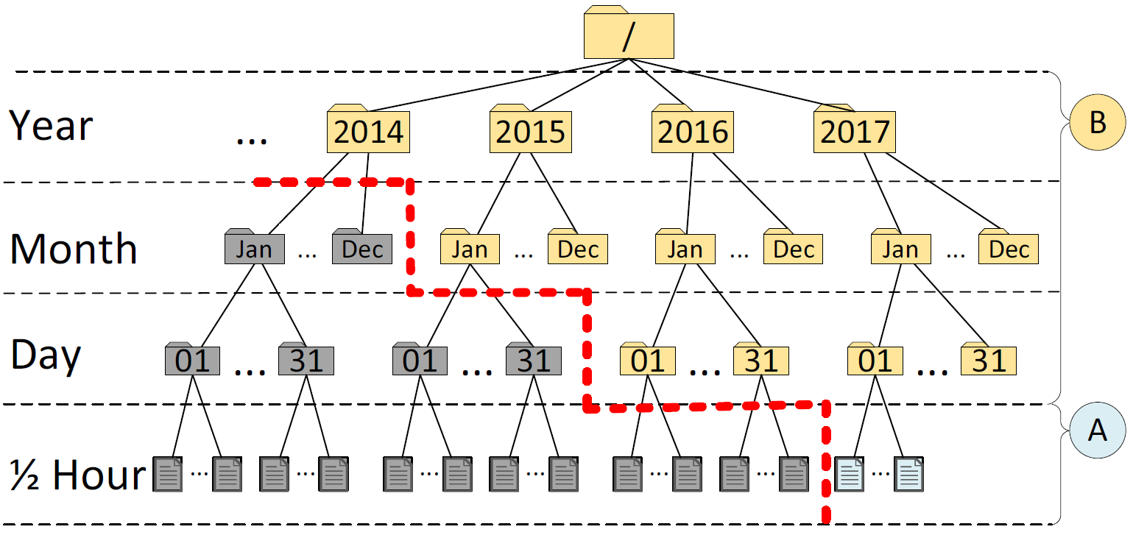
Indexing Layer: Modules
Storage
Our spatio-temporal index has 4 levels of temporal resolutions
  epoch (30 minutes), day, month, year.
A) Incremence Module
  Add compressed snapshots on the right-most path

Slide 48
Indexing Layer: Modules
Storage
B) Highlights Module
  materialized views to long-standing queries of users (e.g., the drop-call counters, bandwidth statistics, etc.)
  essential for multi-granular visual analytics!

Slide 49
Data Decaying
Storage
Data Decaying refers to the “progressive loss of detail in information as data ages with time until it has completely disappeared.”
  M. L. Kersten, “Big data space fungus,” in CIDR’15
Benefits:
  Retain same data exploration capabilities.
  Save enormous amounts of storage and I/O.
Alternative definition referring to DB Schema Decay also exists, but is not applicable here.
  M. Stonebraker, R. Castro, F. Dong Deng, and M. Brodie, “Database decay and what to do about it.” 2016. [Online]. BLOG@CACM: https://goo.gl/tJNa9m.

Slide 50
Indexing Layer: Modules
Storage
C) Decaying Module
  Data Fungus: “Evict Oldest Individuals”
  More Data Fungus to be investigated in the future

Slide 51
Application Layer: SPATE-UI
Storage
The SPATE UI over the San Diego area with data from https://www.cellmapper.net/map
Demo!

Slide 52
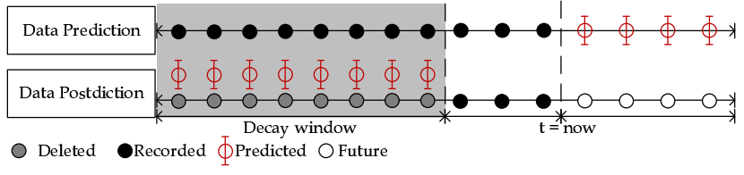
Data Postdiction
Storage
Data Postdiction (DP): aims to recover the past value of some tuple, which has been decayed for efficiency purposes, using a ML model.
  Data Prediction: aims to make a statement about the future value of some tuple using a ML model.

Slide 53
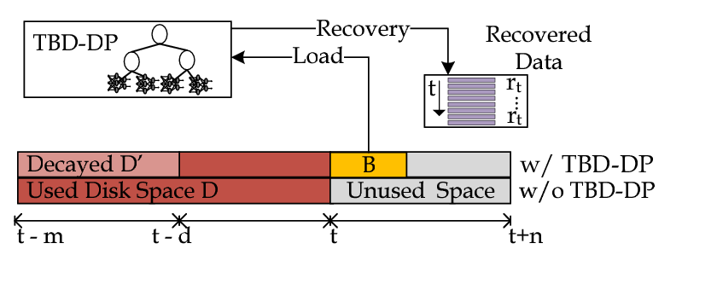
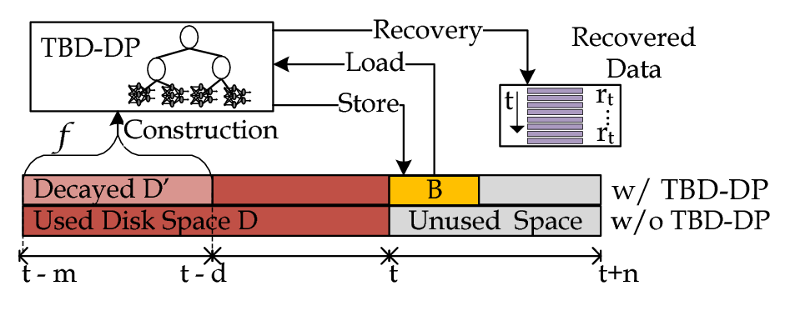
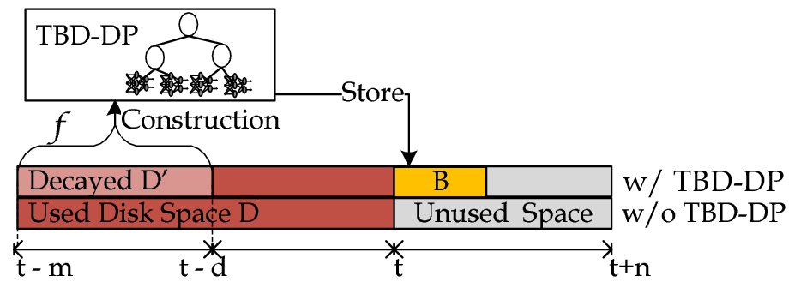
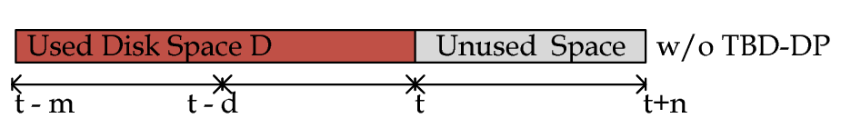
TBD-DP Operator
Storage
TBD-DP Operator Overview
  Construction algorithm: construct a DP-tree (B), for a percentage (f) of the historic data (D), denoted as D’.
    Delete D’ and retain B for data recovery.
  Recovery algorithm: use {B, D-D’} to recover any past data blocks, upon demand.
    D = full data resolution and B = model data resolution

Slide 54
ML, NN, RNN and LSTM
Storage
Machine Learning (ML): uses statistical techniques to give computers the ability to "learn" with data, without being explicitly programmed.
  Neural Network (NN): class of ML algorithms that model complex relationships between inputs & outputs in non-linear processes (e.g., classification, pattern/character recognition)
  Recurrent NN (RNN): directed graph along a sequence able to have short memory (e.g., timeseries, speech, text/spam)
  Long-Short Term Memory (LSTM): special type of RNN capable of having long memory, i.e., long-term dependencies (e.g., language modeling / autocompletion, machine translation)
output
output
output
output
output
output
output
output
output
output
Hidden nodes/ layers
tanh
input
input
input
input
input
input
input
input
input
NN
RNN
LSTM
input
Notes:
https://en.wikipedia.org/wiki/Recurrent_neural_network
Autocompletion: Learn on Search Logs=> what the users finally followed. Then provide Autocompletion Functionality
TPU (Tensor Processing Units): designated

Slide 55
Outline
Introduction
What is Telco Big Data?
Research State & Open Problems
  Real-time & Offline Analytics
  Churn Prediction
  Privacy
  Storage
  Road Traffic Mapping
  Visual Exploration

Slide 56
Road Traffic Analytics with TBD
Road Traffic
INRIX reports that congestion costs U.S. drivers nearly $300 Billion in 2016, which is an average of $1400 per driver per year (both direct and indirect costs)
  INRIX Inc. 2017. Los Angeles Tops INRIX Global Congestion Ranking. (2017). https://goo.gl/c2K3E1 Accessed 7-Aug-2017.
"Towards Real-Time Road Traffic Analytics using Telco Big Data", Constantinos Costa, Georgios Chatzimilioudis, Demetrios Zeinalipour-Yazti, Mohamed F. Mokbel, Proceedings of the 11th Intl. Workshop on Real-Time Business Intelligence and Analytics (BIRTE), collocated with VLDB 2017 (BIRTE '17), ACM International Conference Proceedings Series, pp. 5:1--5:5, August 28, 2017, Munich, Germany, ISBN: 978-1-4503-5425-7/17/08, 2017.
Rank | City / Large Urban Area | 2016 Peak Hours Spent | Total Cost Per Driver in 2016 | Total Cost to the City in 2016 (based on city population size)
1 | Los Angeles, CA | 104 | $ 2,408 | $9.7bn
2 | New York, NY | 89 | $ 2,533 | $16.9bn
3 | San Francisco, CA | 83 | $ 1,996 | $2.5bn
4 | Atlanta, GA | 71 | $ 1,861 | $3.1bn
5 | Miami, FL | 65 | $ 1,762 | $3.6bn

Slide 57
Background: Traffic analytics
Road Traffic
First Era (1E) traffic mapping
  dedicated hardware
    magnetic loop detectors or traffic cameras mounted on traffic lamps or road-sides
Second Era (2E) traffic mapping
  handheld-based and probe vehicles
    Taxis or Buses were equipped with a smartphone and a dedicated app for location updates
    MIT Cartel (http://cartel.csail.mit.edu/doku.php)

Slide 58

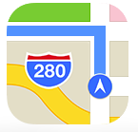



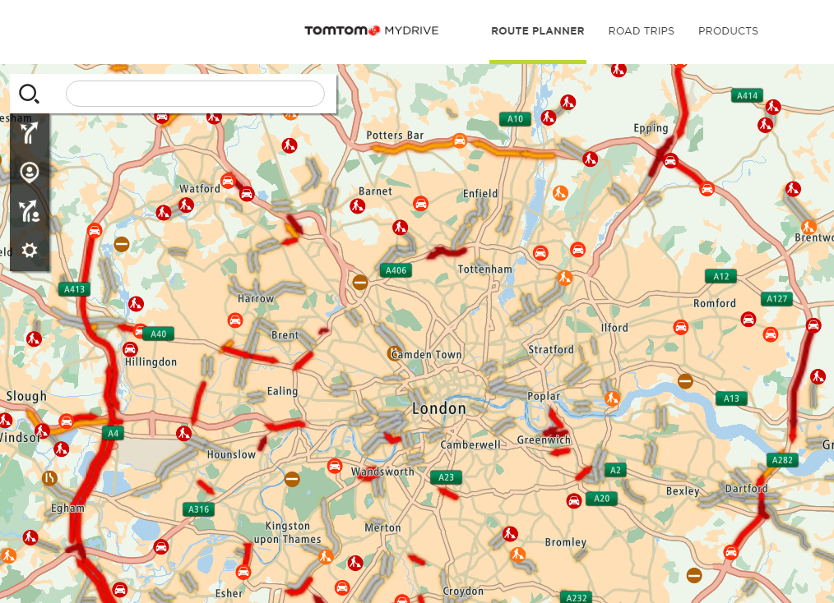
Background: Traffic analytics
Road Traffic
Second+ Era (2.5E) traffic mapping
  opportunistic crowdsourcing
Third Era (3E) traffic mapping
  Traffic-TBD: TBD data to generate the traffic mapping both accurately, without additional hardware and additional costs.
  E.g., TomTom MyDrive

Slide 59
TrafficTBD Example Queries
Road Traffic
A1. Hot Spot Analysis:
  Detect and visualize the most congested areas around a location.
A2. Navigation Monitoring:
  Calculate and visualize the best route based on the travel time and traffic queue length.
A3. Travel time:
  Calculate aggregated time loss due to congestion.
A4. Travel speed:
  Determine average speed based on the traffic flow.

Slide 60
TrafficTBD Example Queries
Road Traffic
A5. Accessibility analysis:
  Compute the time that is needed to reach a specific location at a specific time slot considering the road traffic.
A6. Incident detection:
  Detects any incidents due to traffic.
A7. Before-after analysis:
  Measure the traffic flow after a change in the road network in order to be evaluated from the traffic administration.
A8. Travel behaviors:
  Identify travel behaviors throughout a region.

Slide 61
Vtrack
Vtrack
  uses Hidden Markov Model to identify tracks based on wifi fingerprints
d8:30:62:5f:be:da, RSSI -94
00:0f:b5:3d:43:20, RSSI -58
00:18:0a:30:00:a3, RSSI -51
. . . . . . . . . . . . . .
42.361,-71.09
42.361,-71.09
42.362,-71.091
. . . . . . . .
Radio fingerprinting
  OK for best static localization estimate
  But poor at identifying tracks
A. Thiagarajan, L. Ravindranath, K. LaCurts, S. Madden, H. Balakrishnan, S. Toledo, and J. Eriksson,
“Vtrack: accurate, energy-aware road traffic delay estimation using mobile phones”, SenSys 2009

Slide 62
Vtrack - Ctrack
Existing Map-Matching Algorithms perform Poorly w/ Cellular Radios
Algorithm
User
A. Thiagarajan, L. Ravindranath, H. Balakrishnan, S. Madden, and L. Girod,
“Accurate, low-energy trajectory mapping for mobile devices”, NSDI 2011

Slide 63
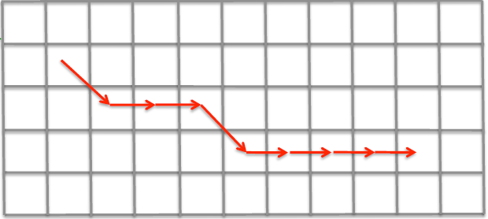
Ctrack
Do not convert radio fingerprints to (lat, lon) coordinates and then sequence them on map (Vtrack)
Instead, first sequence GSM fingerprints on a spatial grid
Time TowerId RSSI
18.03 334490560 14
334478599 12
337772865 18
334478600 14
334470539 12
334490699 12
19.01 . . . . .

Slide 64
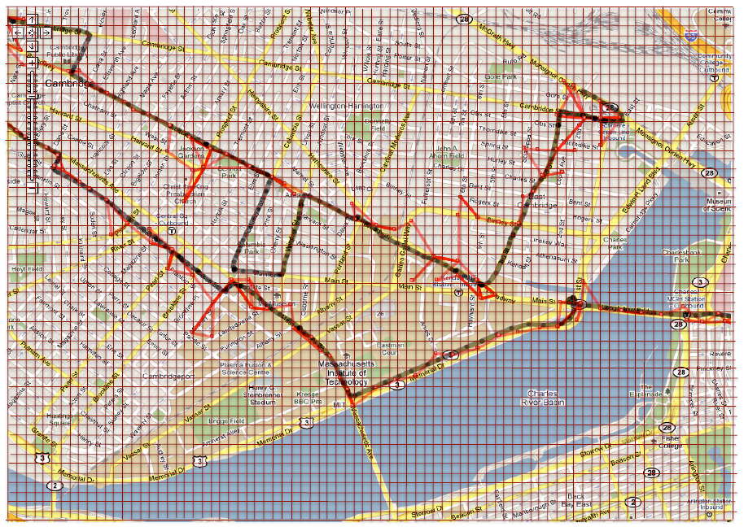
Ctrack
Raw points
HMM fingerprints
Smooth + interpolate
grid sequence
HMM smooth
grid to map

Slide 65
Outline
Introduction
What is Telco Big Data?
Research State & Open Problems
  Real-time & Offline Analytics
  Churn Prediction
  Privacy
  Storage
  Road Traffic Mapping
  Visual Exploration

Slide 66
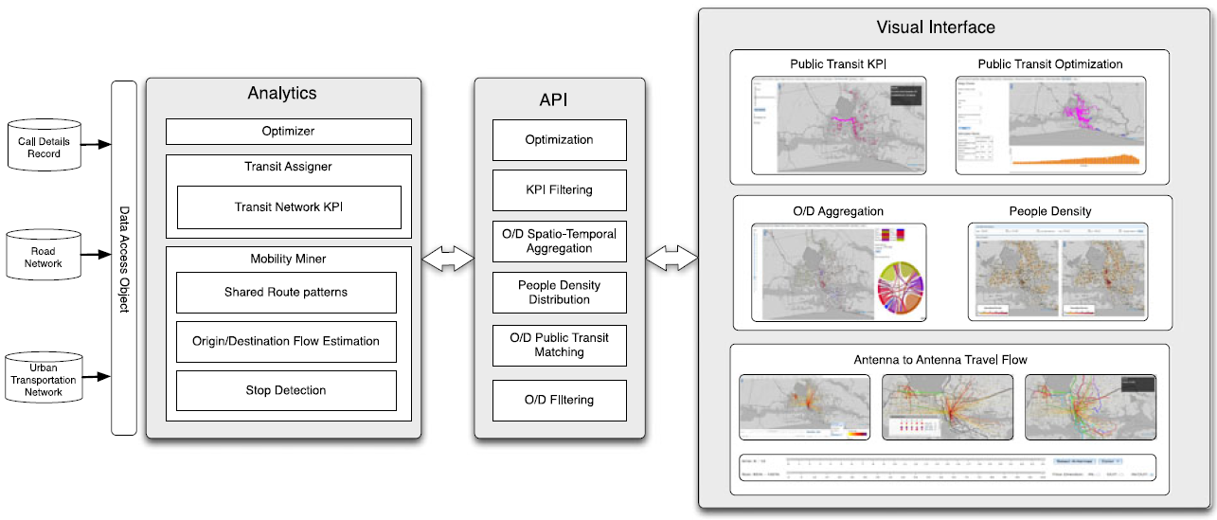
AllAboard
Visual Exploration
G. Di Lorenzo, M. Sbodio, F. Calabrese, M. Berlingerio, F. Pinelli, and R. Nair,“Allaboard:
Visual exploration of cellphone mobility data to optimise public transport”, TVCG, 2016

Slide 67
AllAboard: Data Modeling
Visual Exploration
Mobility Mining
  Extracts the location of the stops
  Estimates the aggregated origin/destination (O/D) paths between the stops
  Extracts the common route patterns
Transit Assignment
  Extracts the transit KPIs
  Provides the optimal O/D path

Slide 68
AllAboard: Data Modeling
Visual Exploration
Optimizer
  Get all the common routes and recommend the shortest path based on:
    a) existing transit network
    b) O/D routes from stops
    c) new routes
    d) travel time
    e) budget

Slide 69
AllAboard: Visual Exploration
Visual Exploration
Spatio-temporal exploration
Selection
Public transport network
Public transport KPIs
Comparison of different strategies

Slide 70
TelCoVis
Visual Exploration
W. Wu, J. Xu, H. Zeng, Y. Zheng, H. Qu, B. Ni, M. Yuan, and L. M. Ni, “Telcovis: Visual
exploration of co-occurrence in urban human mobility based on telco data”, TVCG, 2016

Slide 71
TelCoVis: Data Modeling
Visual Exploration
Population Mapping
  map users to different regions
Co-occurrence Events Extraction
  construct a co-occurrence graph to extract co-occurrence events
Correlations Mining
  transform the constructed co-occurrence graph into a binary matrix
  mine the correlations in co-occurrence efficiently

Slide 72
TelCoVis: Visual Exploration
Visual Exploration
Map View
  flow-out map & flow-in map
Matrix View
  provides an overview of correlations in co-occurrence through biclustering

Slide 73
TelCoVis: Visual Exploration
Visual Exploration
Contour-based Treemap View
  the number of visitors per period of a day
  the distance between the place and the region they come from
  the loyalty of those regions
Extended LineUp View
  conveys the diversity in those biclusters

Slide 74
TelCoVis: Visual Exploration
Visual Exploration
Parallel Coordinates View
  multivariate data visualization
  each bicluster as a polygonal line.

Slide 75
TelcoFlow
Visual Exploration
Y. Zheng, W. Wu, H. Zeng, N. Cao, H. Qu, M. Yuan, J. Zeng, and L. M. Ni, “Telcoflow: Visual
exploration of collective behaviors based on telco data”, Big Data, 2016

Slide 76
TelcoFlow: Data Modeling
Analyze data characteristics
  records between each mobile phone and cell stations
    <Timestamp, IDphone, IDstation, Latitudestation, Longitudestation>.
Propose a state-based behavior model
Use this model for collective behavior detection.

Slide 77
TelcoFlow: Visual Exploration
Visual Exploration
Multi-facet Filter View
  aggregation and filtering in multiple aspects
Flow View
  provides an overview of collective behaviors through state-based modeling

Slide 78
TelcoFlow: Visual Exploration
Visual Exploration
State View
  based on identified state clusters (Flow View)
  radial distribution map
  radial distance map
Sequence View
  visualizes the extracted sequences of state clusters

Slide 79
Telco Big Data Research and Open Problems
Thanks! Questions?
Constantinos Costa and Demetrios Zeinalipour-Yazti
Advanced Data Management Technologies Laboratory (ADMT) Dept. of Computer Science, Univ. of Pittsburgh, Pittsburgh, PA, USA | Data Management Systems Laboratory (DMSL) Dept. of Computer Science, Univ. of Cyprus, 1678 Nicosia, Cyprus
Slides:
https://dmsl.cs.ucy.ac.cy/tutorials/icde19
IEEE ICDE 2019 - 35th IEEE International Conference on Data Engineering
Macau SAR, China, 8-12 April, 2019

